Slide 1
Lecture 2: Problems in Machine Learning

Slide 2
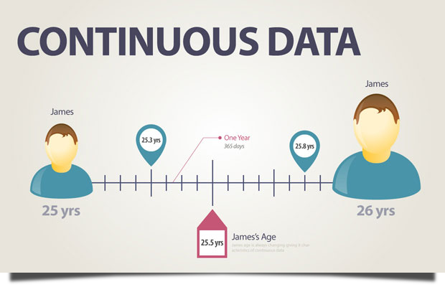
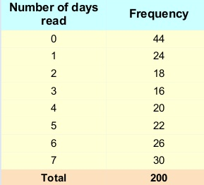
Is your data???
Continuous or discrete?
How many days this week did you read the newspaper?

Slide 3
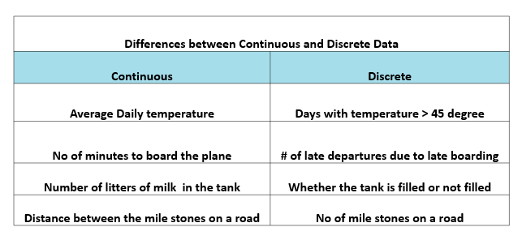
Is your data???
Continuous or discrete?

Slide 4
Is your data???
Continuous or discrete – could you decide?

Slide 5
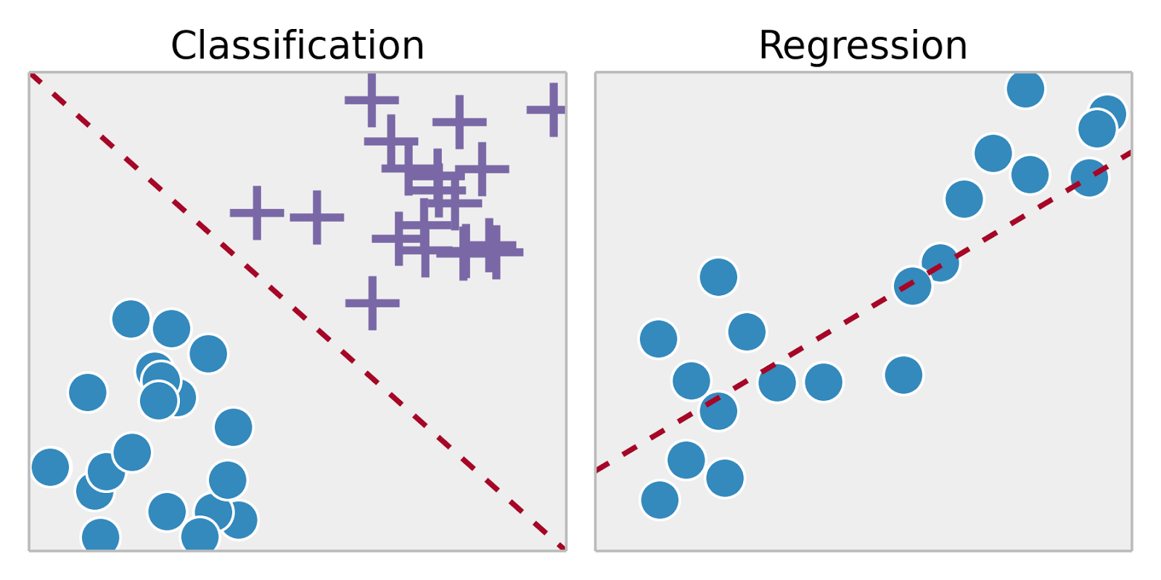
Is your data???
Based on classification?

Slide 6
Is your data???
Based on classification?
  Spam vs not spam
  Insure vs don’t insure
  vs
  Spam vs important vs “general”
  Don’t insure, low rate, average rate, high rate

Slide 7
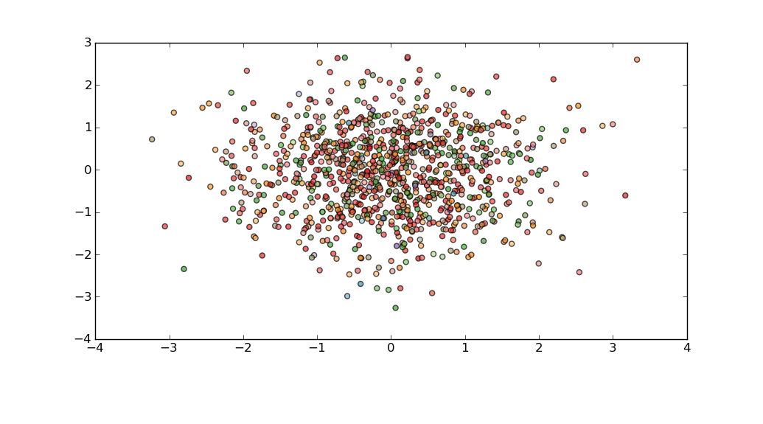
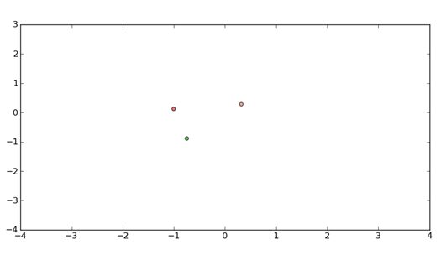
Is your data???
Abundant vs rare

Slide 8
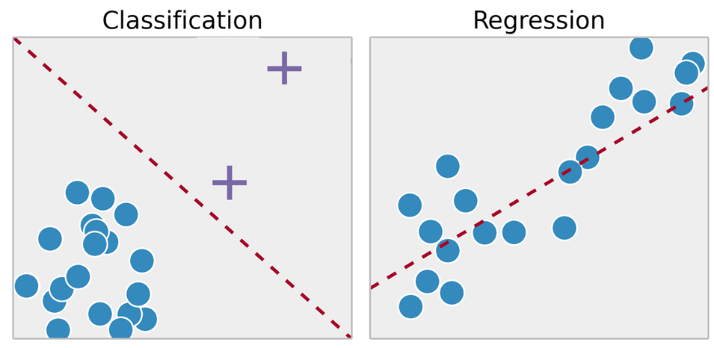
Is your data???
Abundant vs rare – or does it depend on which kind of data?

Slide 9
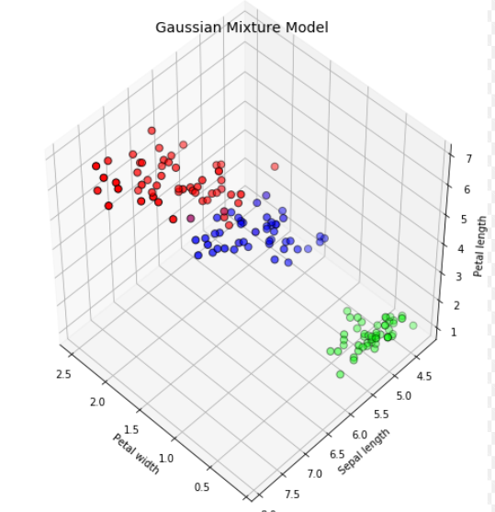
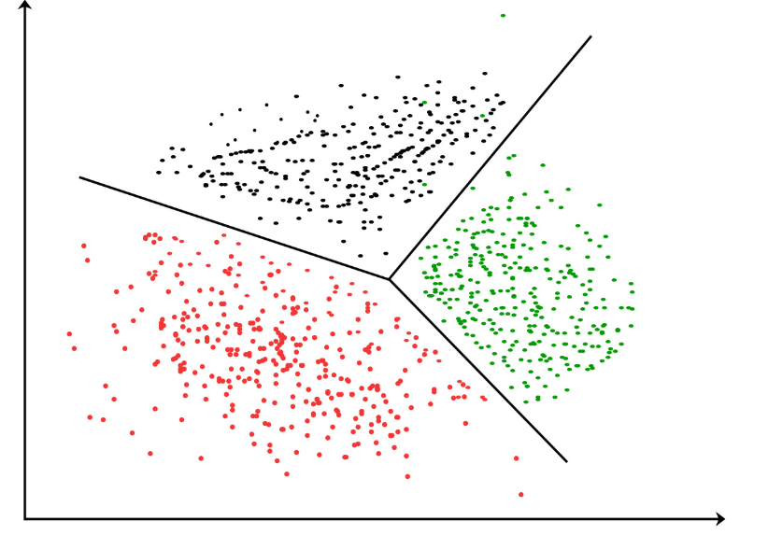
Is your data???
Single- or multi-variable

Slide 10
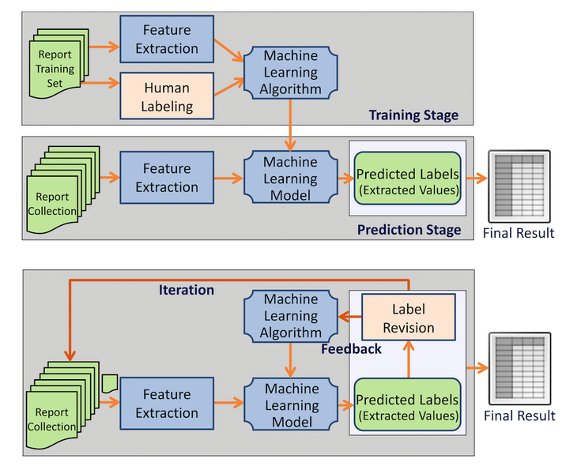
Is your data???
Available all at once or given piece-by-piece

Slide 11
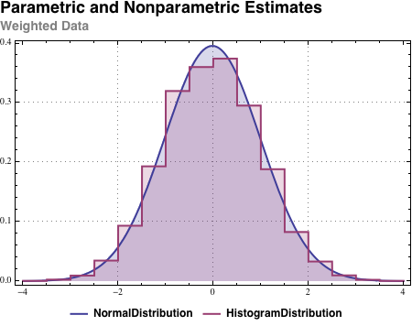
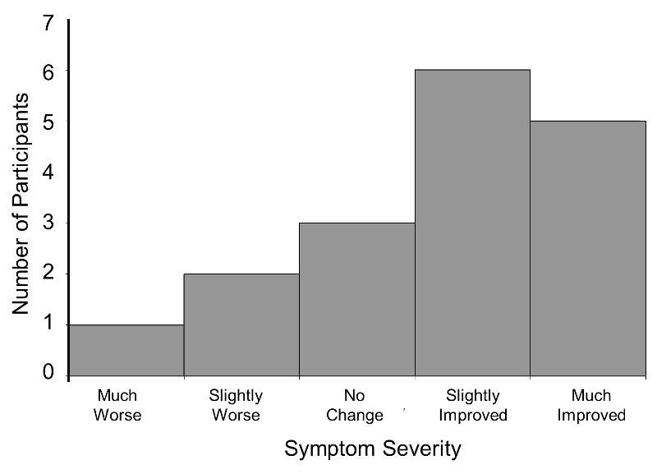
Is your data???
Based upon an underlying statistical model?

Slide 12
Is your data???
Based upon an underlying statistical model?

Slide 13
Is your data???
You can (and will have to) combine all of these things (and more) just to describe your data
Your choice of machine learning tool/algorithm will depend on all of these factors
This diversity of data drives the diversity of solutions that exist to make sense of data

